Slide 1
Flutter vs React Native

Slide 2
Eco System
Flutter:
Free and open source
Dart programming language
Support for development on Windows, Linux, mac desktop
Tooling for Android Studio and Visual Studio Code
Flutter uses C++ rendering engine
Architecture is based on reactive programming.
React Native:
Open-source mobile application framework
Founded by Facebook in 2015.
Support for development on Android & iOS
React Native is originated a bit early and has the marketplace.
Tons of packages already.
Tooling RN developers are free to use any text editor or IDE of their choice like Atom, Visual Studio Code etc.

Slide 3
Programing Language
React Native
JavaScript is used
As JavaScript is widely used by most web developers, it’s easy to adopt the React Native framework.
React Native has to rely on third-party libraries. React Native is too much dependent on third-party libraries.
Supports “Hot Reloading” that enables simultaneously running new code and keeping hold of application state, instead of recompiling. This makes development faster, instant, and efficient.
Flutter
Developed by Google and is used to build mobile, desktop, backend and web applications.
Object-oriented, garbage-collected language using a C-style syntax that trans compiles optionally into JavaScript.
Dart supports both AOT (Ahead Of Time) and JIT (Just In Time) compilation.
JIT compilation provides exceptionally fast development cycles and game-changing workflow
Smooth animations and transitions that run at 60fps.
Object allocation and garbage collection without locks.
Avoids preemptive scheduling and shared memory
All Flutter apps are compiled to native code. In turn yields faster startup time.
Declarative, programmatic layout is easy to read and visualize.
One language and in one place, provides advanced tooling that makes layout a snap.
Developers migrating from both static and dynamic languages have found the language particularly easy to learn because it has features that are familiar to users.

Slide 4
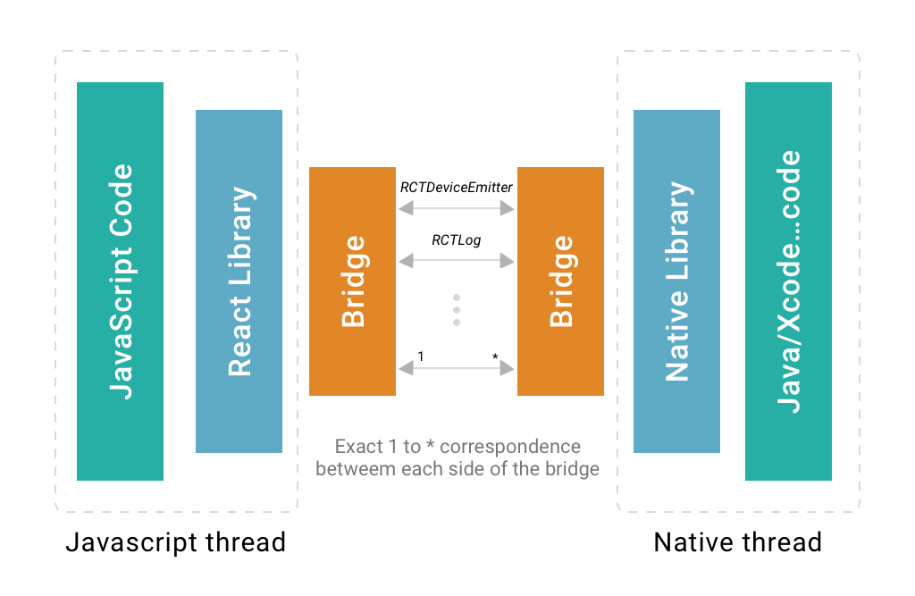
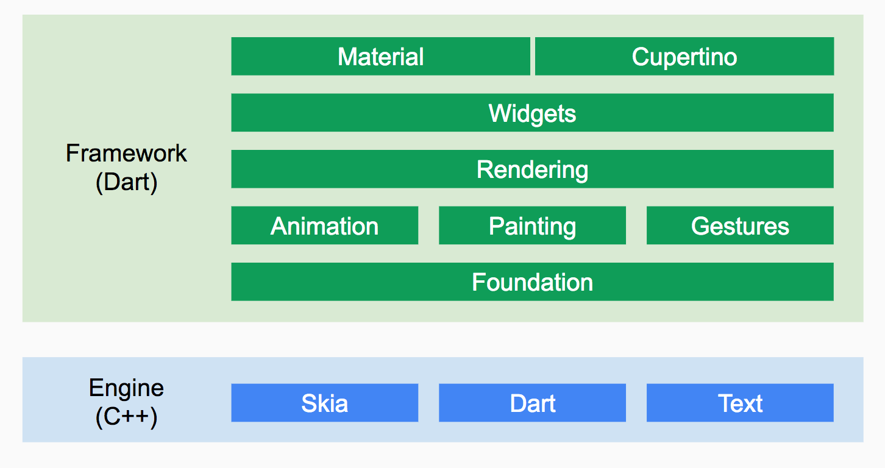
Architecture
React Native
Flutter

Slide 5
Learning Curve
React Native
Easily adaptable for front-end developers as it uses JavaScript Technology
Web developers can build mobile apps with minimal training
Reusable components are available, so no need of re-work which speeds up the development
Standard documentation & video tutorials are available for learning
Flutter
Fast learning curve due to component based design.
Dart programing language is object oriented thus making it easier to be adopted by programmers from C# and Java background.
UI components that integrate the guidelines of Material Design and Cupertino, which speeds up development
Official channel is available on Youtube under the name - Boring Flutter Development Show.
Lots of documentation available.

Slide 6
Developer Perspective
Flutter
Offline capability using SQLite DB
Easy integration of Maps - Google Maps plugin for Flutter is available
Camera/Biometrics plugins are available
Push Notifications – Firebase is only supported. OneSignal sdk is available for flutter
OAuth2 Integration - Azure Active Directory, Amazon, Dropbox, Facebook, Github, Google, Instagram, Linked In, Microsoft Live Connect, OAuth2/Basic Auth server.
Analytics- Supports Adobe/ Firebase
Continuous delivery using fastlane with Flutter
Supports Automated testing - Unit test ,Widget UI testing , Integration Testing
CI/CD support – CodeMagic , Bitrise, CircleCI
React Native
Installation is easy through NPM
Large & active community support
Easily adaptable for front-end developers as it uses JavaScript
Developers can use any IDE according to their convenience
Offline capability using Async Storage, SQLite DB, Realm
Easy integration of Maps, Push Notifications, OAuth, Fabric, Navigation etc. using third party libraries
Analytics- Supports Google/ Firebase
Supports Automated testing - Unit test, Component testing, Integration Testing , functional testing
Jest, Detox, Enzyme tools are supported for testing

Slide 7
Performance
React Native
React Native uses the native APIs to achieve native-like experience
It supports “Live/Hot Reloading” which makes development faster.
Build and display frames in 16.67ms
Uses the JavaScript Bridge to communicate with native modules, which results in poor performance in some cases
Navigation is not smooth as compared to native apps.
App’s performance can be monitored using Performance Monitor
Flutter
Fast with Hot reload
Performance profiling can be done easily with integrated tools.
Build and display frames in 16ms
Render grids and lists lazily
App’s performance can be monitored using rendering mechanism and its rendering frame duration using widget rebuild information
Supports 3 types of build modes- Debug/Release/Profile
Flutter analyzer helps you find possible mistakes.

Slide 8
Pros & Cons
React Native
Pros
More than 4 years in market with the ability to deliver native like experience
Uses Virtual DOM which improves the app performance
Huge & active community
Supports Live & Hot reloading
Reusability of components. Inbuilt Components Increase Development Speed.
Time and cost efficiency
Performance Monitor is available to see the performance while developing the app
Developer can inspect UI components of the app on device/simulator which helps in faster development.
Easy to Debug the app using React Native Debugger
Cons
Uses the JavaScript bridge to communicate with native modules, which results in poor performance.
In order to access most of the native modules, React Native has to rely on third-party libraries
Less Smooth Navigation
Developers with native language experience are needed
Flutter
Pros
Ready-made and custom widgets for fast UI coding
The mildest learning curve and a growing community
Dart – simple and effective language targeted at Java programmers
Both AOT and JIT compilation types.
No need for XML files
Hot reload function for instantaneous updates
Portability, Reusability
Single codebase for web, mobile and embedded platforms
Flutter uses a flexible system that allows you to call platform-specific APIs whether available in Java or Kotlin code on Android, or in Objective-C or Swift code on iOS
Cons
Lack of third-party libraries
Large file size
Issues with iOS
Large number of open issues in GitHub (5000+)
Flutter uses several threads to do its work. All your Dart code runs on the UI thread. Although you have no direct access to any other thread, your actions on the UI thread have performance consequences on other threads.
Image I/O can be expensive

Slide 9









Who is Using - Flutter
Google Ads
Reflectly
JD Finance

Slide 10

Who is Using – React Native

Slide 11
DOCUMENTATION & COMMUNITY SUPPORT
React Native
https://facebook.github.io/react-native
https://github.com/facebook/react-native
https://www.youtube.com/results?search_query=react+native
https://github.com/facebook/react-native-website
https://github.com/facebook/react-native#-documentation
https://devdocs.io/react_native/
Flutter
https://flutter.dev/docs/get-started/install
https://flutter.dev/docs/development/ui/widgets
https://api.flutter.dev/
https://flutter.dev/docs/cookbook
https://github.com/flutter/samples/blob/master/INDEX.md
https://www.youtube.com/flutterdev
https://dart.dev/

Slide 12
Communities
React Native
https://github.com/facebook/react-native
https://stackoverflow.com/questions/tagged/react-native
https://twitter.com/reactnative
https://medium.com/reactnative
http://www.reactnative.com
https://reactnativeexample.com/
Flutter
https://github.com/flutter
https://stackoverflow.com/tags/flutter
https://twitter.com/flutterdev
https://medium.com/flutter
FilledStacks
Welcome to Flutter
SZAŁKO-BLOG
Flutter by Example
Flutter Institute
Iirokrankka.com
Norbert -
Flutter Tips
https://github.com/Solido/awesome-flutter

Slide 13
Thank You !!

